Slide 1
Programming 1 - WEEK 6
Skills

Slide 2
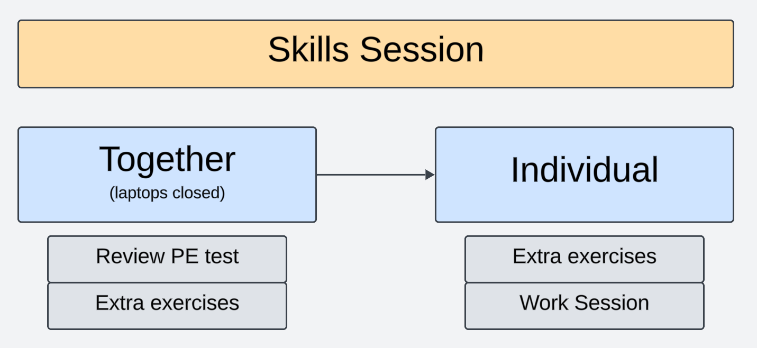
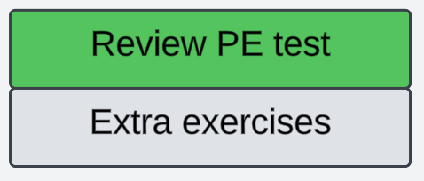
Approach

Slide 3
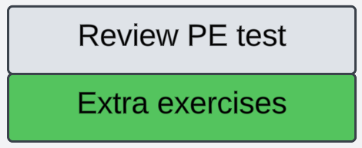
Approach

Slide 4
Bookshop
We will implement some functionality for a simplified bookshop.
The bookshop holds 2 dictionaries:
One with information about the books they sell
One with information about the preferences of their customers
We are interested in adding information to the dictionaries, retreiving information, and combining information about books and customers.
Note that our implementation will not tackle case sensitivity.
The following weeks we will look into other concepts to tackle this implementation more efficient and user friendly!

Slide 5
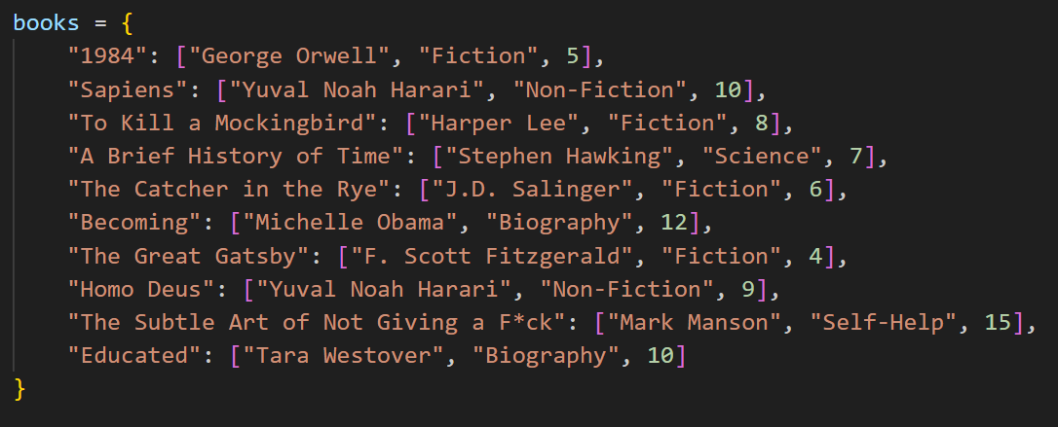
Bookshop (1)
Given the dictionary books, with title as key, and a list of details as value. The list of details consists of the author, the genre and the stock.

Slide 6
Bookshop (1)
Given the dictionary books, with title as key, and a list of details as value. The list of details consists of the author, the genre and the stock.
Write the following functions:
add_books ( books , title , author , genre , stock )
If the title already exists in de dictionary, adjust the stock
No other input validation needed
books_by_author ( books , author )
Return a set with all books from the given author
check_availability ( books , title )
Return True if the title exists in the dictionary and the stock is above 0, False otherwise

Slide 7
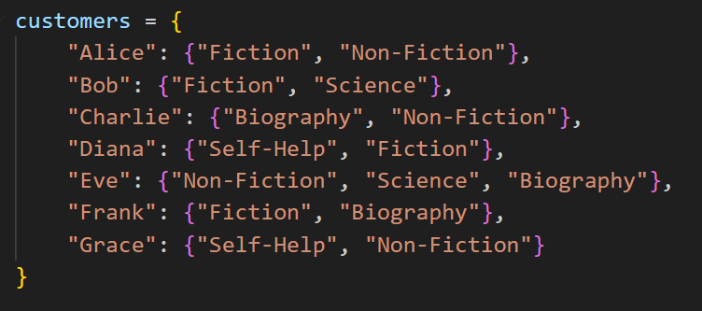
Bookshop (2)
Given the dictionary customers, with name as key, and a set of genres as value.

Slide 8
Bookshop (2)
Given the dictionary customers, with name as key, and a set of genres as value.
Write the following functions:
add_genre ( customers , name , genre )
If the customer doesn’t exist in de dictionary, add the customer with the given genre
No other input validation needed
all_genres ( customers)
Return a set with all genres the customers are interested in
recommend_books ( books , customers , name )
Return a set with all book titles that correspond with the preferred genres of the given customer

Slide 9
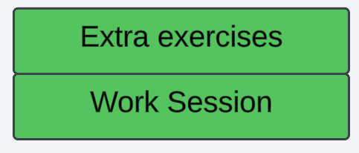
Approach
Notes:
De extra oefeningen staan op Toledo. Het is een goed idee om die nu ook zelf op te lossen, op die manier kan je pas echt aftoetsen of je het goed begrepen hebt.
Ik kom rond om te helpen bij vragen.

